Slide 1
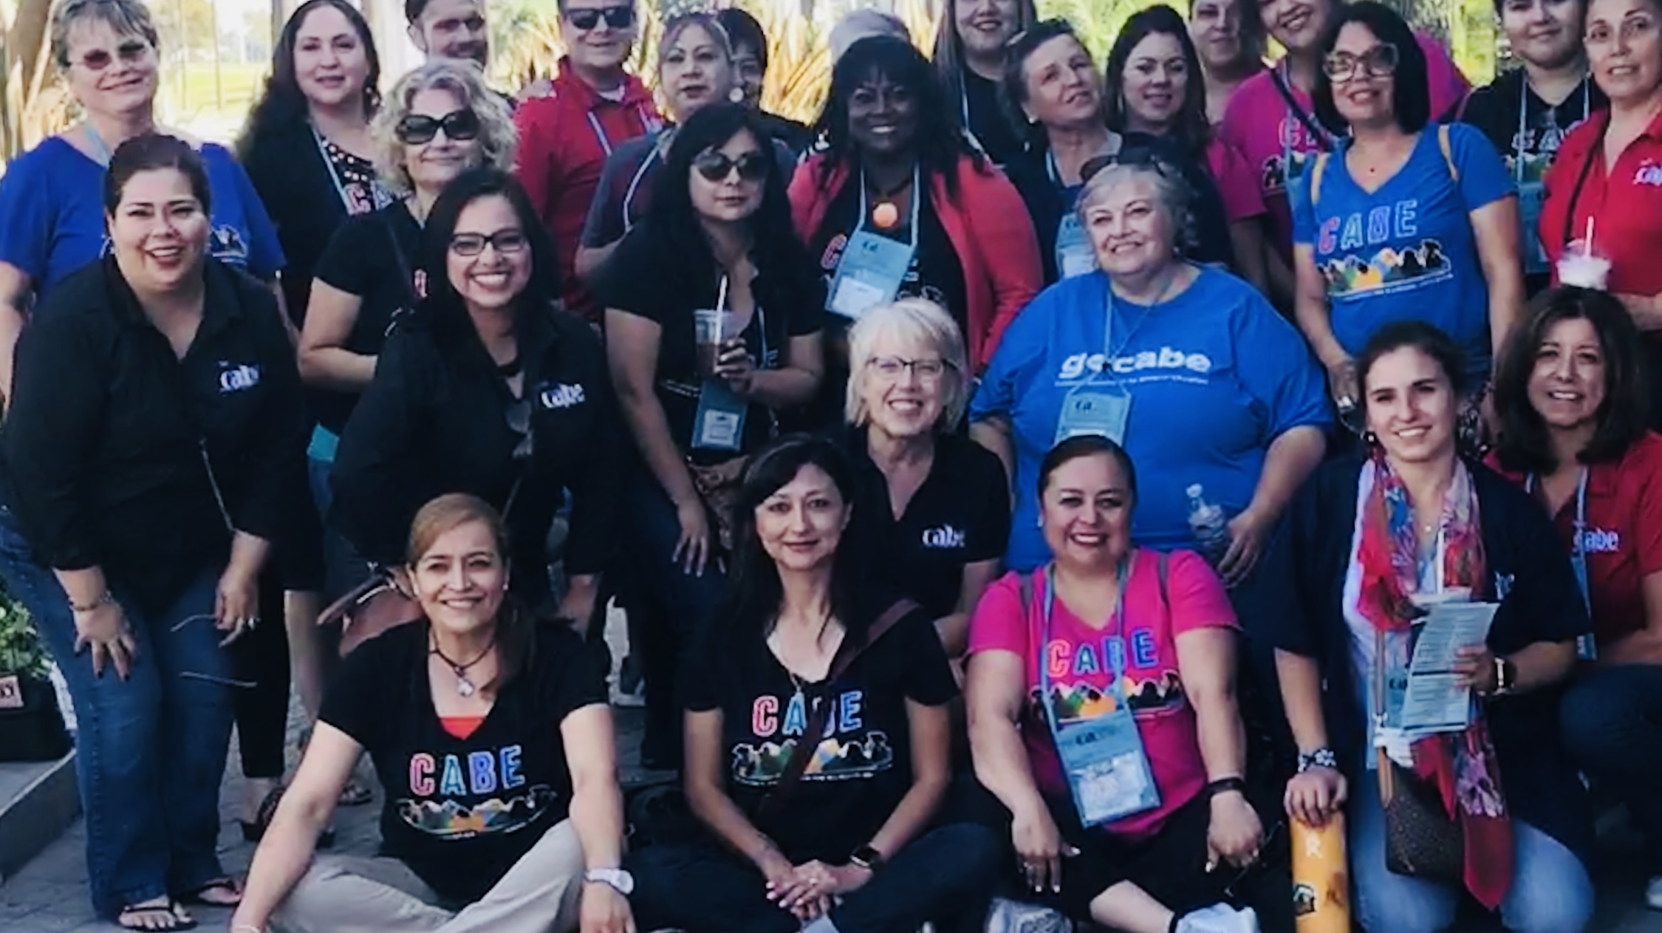
CABE Connections Across Our Organization

Slide 2

CONFERENCES DLI--370,
Bakersfield--340 Monterey—308
CABE 2019
PARENT FAMILY ENGAGEMENT
NPD—Rialto & Fontana
Contracts:
CCEE CEI
CA Endowment: SIRS
ADVOCACY
Legislative
SBE, CDE
CTC
Bills
Budget
PARTNERS
PROFESSIONAL DEVELOPENT
PDS
DLI Summer Inst; 370
Binational GLAD: 60
Bakersfield: 101
Monterey: 126
Contracts:
BEST
TEACHERS—15
ADMINS: 65
CABE
Cal Tog/ELLLI
Sobrato EL Policy
Ed Trust West, Advancement Project, The Budget Center, CEEL, Early Edge,
CCEE CEI
SBCSS, FIS, CCEE
National EL RoundTable
CDE
Quarterly Mts with SPI
BTPDP
ALI
Translation of Docs
ABEs
Transition—SPI
NABE
CABE--Colorado
DLeNM
WABE
TABE
NMABE
BINATIONAL
SEE--BC
SRE-IME
Consulados
UC Mexico
Peru
Cuba
OUTREACH
Chapters, Publications
CABE Corner, ME
Website, Facebook
CTA
PTA
CSBA
CAAASA

Slide 3

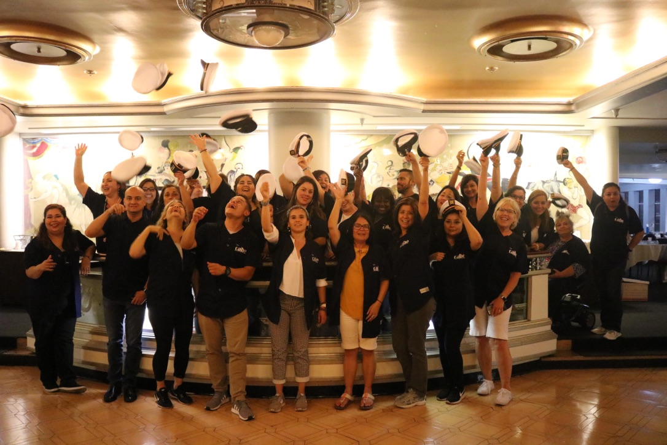
Our Values
Equity • Servant Leadership • Respect •
Cultural and Linguistic Human Rights • Integrity….and fun!

