Slide 1
here we come….!
CABE Board Meeting
March 19, 2019

Slide 2
THE PROGRAM
HARDCOPY
WEBVERSION—cabe2019.org
CABE APP
SCHED

Slide 3
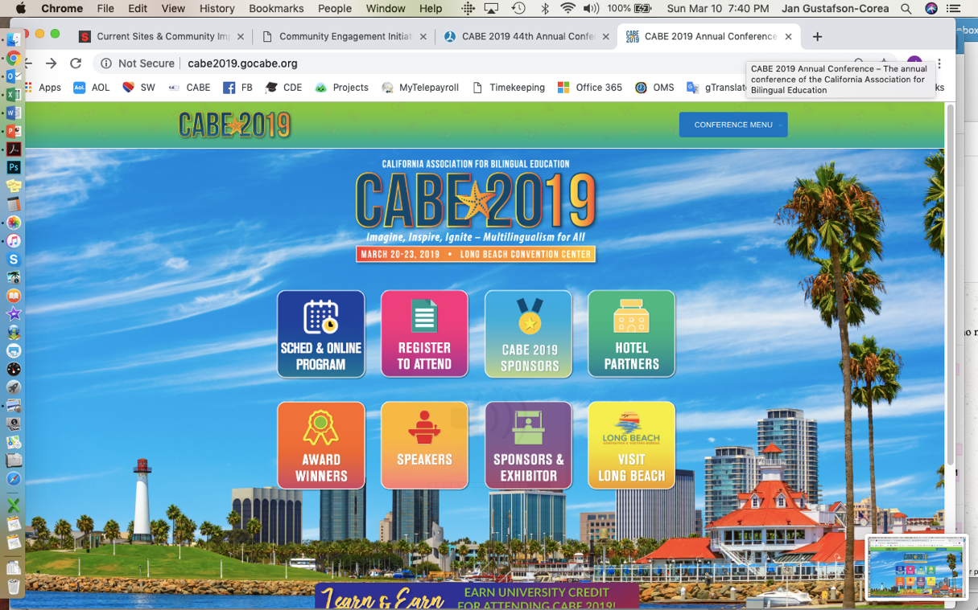
THE CABE 2019 WeBSITE www.cabe2019.org

Slide 4
KEYNOTES
CULTURE CLASH ZOE SALDANA JEFF DUNCAN ANDRADE BAO PHI

Slide 5
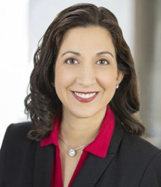
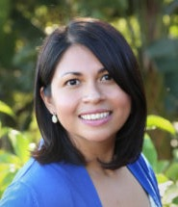
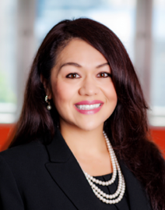
DIGNITARIES
  Tony Thurmond
  Lupita Cortez Alcala
  Tom Torlakson
  Daisy Gonzalez
  Feliza Ortiz-Licon
  Tom Adams
  Miguel Angel Mendoza
  Carlos Garcia de Alba
  Mercedes Martinez
  Ramona Webb

Slide 6
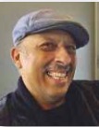
BOARD AWARDS
TOM TORLAKSON--WED
MIGUEL ANGEL GONZALEZ-WED
NORM GOLD
AMPARO LOPEZ—THURS
CHAPTER OF THE YEAR--THURS
CTA-FRI
Jorge Bermudes-FRI

Slide 7

EL ROADMAP POLICY—Going Deeper
FOCUS THROUGHOUT CABE 2019
PAGAS 62-64 IN PROGRAM
GENERAL SESSIONS FOCUS
WORKSHOPS
ALS

Slide 8
KEY PARTNERS
ELLLI
Norm Gold & Steering Committee
Fellows
Mentors
INTERNATIONAL
Mexico
IME & SEP
SEE
Consulado—LA
Spain
Peru
Sobrato Family Foundation
  Kenji Treanor
  Doua Thor
  Anya Hurwitz
  Laurie Olsen
National EL Round Table
NABE
Language Policy Institute
Californians Together
  Shelly Spiegel-Coleman
  Martha Hernandez
  Xilonin Cruz Gonzlaez
  Claudia Viscarra
  Van Ou
  Lynne Aoki
  Marlete Batista
CDE
TONY THURMOND
LUPITA CORTEZ ALCALA
TOM ADAMS
Veronica Aguila
Elena Farjado
Lorrie Kelling
Marcela Rodriguez, etc
OTHER KEY PARTNERS
  DLeNM
  LMU---CEEL
  Advancement Project
  Ed Trust West
CAL
CALSA
CLSBA

Slide 9
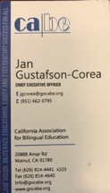

NETWORKING
CARRY BUSINESS CARDS &WEAR YOUR NAME BADGE EVERYDAY!
Tuesday Reception—5:30-7:30 at Hyatt—Beacon B
Wednesday—Membership Reception & Dance
Wednesday—Mexican Delegation Reception—9:00, CABE Suite
Thursday—Partner Receptions and President’s Reception—7:30 at Hyatt BEACON A
Friday Seal of Excellence Dinner and Dance
Vendors/Sponsors

Slide 10
OTHER SPECIAL EVENTS
INVITATION ONLY OR PRE-Reg required
TUESDAY
CABE Board Meeting & Lunch—Tuesday, 3/19, 7:30-1:30 | Hyatt, Beacon A
WEDNESDAY
JDA—Wednesday, 3/20, 8:30-3:30 | Hyatt, Beacon A
Project BEST—Teachers
Tony Thurmond & Miguel Angel Mendoza Lunch-1:00-2:15
CABE Women’s Leadership Tea—Wednesday, 3/20, 1:30-2:45, LBCC Grand Ballroom A
ELLLI Reception—Wednesday, 3/2o, 6:30 p.m. | Rock Bottom Restaurant
Mexican Delegation Reception—Wednesday, 3/20, 9:00 p.m. | CABE Suite
THURSDAY
Ginger & Wayne—Special Meetings with DELIGHT, BEST Admin, and Seal of Excellence Schools
Private Receptions (Palmdale, Pepperdine, Sobrato/SEAL, CALSA)
FRIDAY
Premios Campoy-Ada—Authors & Illustrators 10:30-11:45-–LBCC 104B and 12:00-1:30 CABE Suite
SATURDAY
Project BEST--TEACHERS
Membership Meeting, Saturday, 3/22, 9:00-10:00 | LBCC Grand Ballroom A
Café Literario—Coffee & Conversation—The Puerto Rican Struggle

Slide 11
THE CABE APP
CABE TEXT MESSAGES
-91096
-TYPE CABE IN TEXT MESSAGE

Slide 12
BOarD SUPPORT & PREP
SCHEDULE
SCRIPTS--Events
SCRIPS—Featured Speakers
Some Non-Speaking Responsibilities
PRESS
PERSONAL RELATIONSHIPS

Slide 13
CABE 2019 DETAILS

