Slide 1


CABE Team Response
April 4, 2020

Slide 2
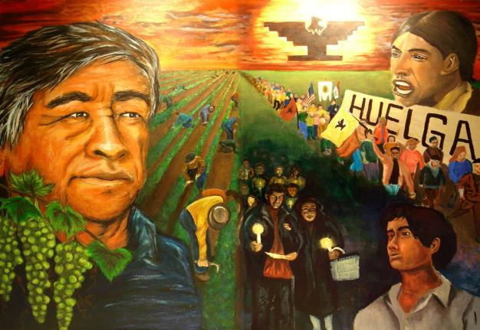
CÉSAR CHÁVEZ
A HERO, A CHAMPION
We draw our strength from the very despair in which we have been forced to live. We shall endure.
- César Chávez

Slide 3
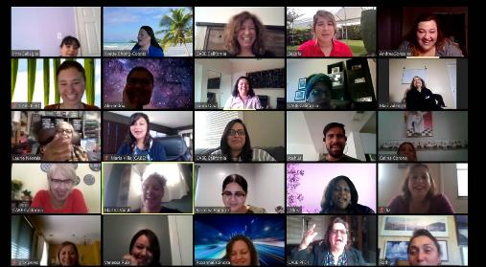
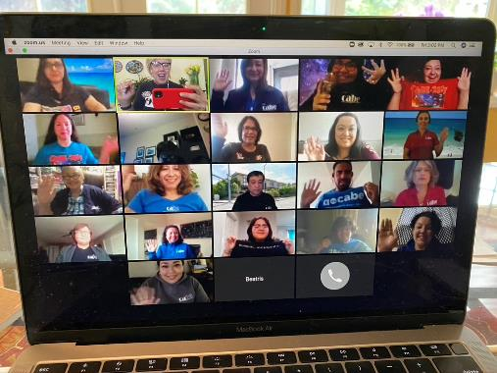
CABE TEAM REMOTE
Staying Connected
March 16—First day of remote work
Laptops and files
Remote Systems
Building Needs
Microsoft Teams
Zoom
Daily check-ins
Weekly mail pick up
Team meetings, individual meetings, partner meetings, meetings, meetings, meetings!
Lots of connections and productive work
Social Emotional Support
Our 6 Cs in Action!

Slide 4
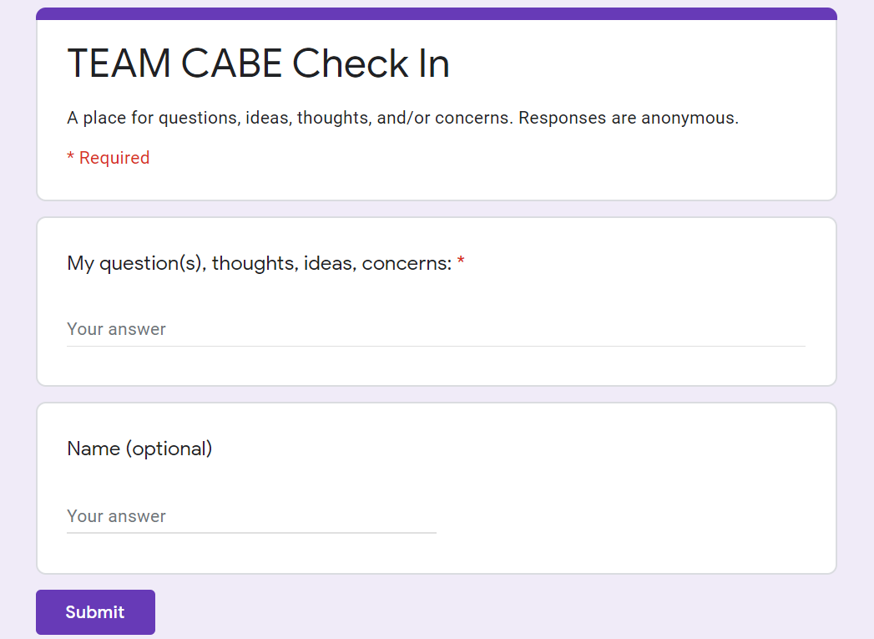
Questions
Ideas
Thoughts
Concerns
Google form for Team Check-in

Slide 5
COORDINATING COUNCIL
Jan
Cynthia
Delma
Josh
María
Norma
Rubí

Slide 6
COVID-19 FOCUS
Team Check-ins and Support
Team Meetings
Technical Support and Facilitation of CABE 2020 Travel Ban Collection Process and Registration
Zoom/Webinar Training Guidance and Support
Facebook Page Guidance and Support
Community Engagement Initiative (CEI)
  Request for Applications- Cohort 2 (RFA on gocabe.org)
  www.Californiaengage.org
Project BEST for Administrators Cohort 2 (2019-2020)
Cynthia

Slide 7
COVID-19 FOCUS
Suspension of CABE 2020
  Rollover or Refund Process
Contracts
Riverside Regional Conference- Alternate Planning
Delma

Slide 8
COVID-19 FOCUS
Building Close Down
Coronavirus Info
Insurance Policies
Team Schedules & HR Support
Membership & Customer Support
Zoom Coordination Team
Josh

Slide 9
COVID-19 FOCUS
Distance Learning and Zoom trainings
Zoom Guides for Families
Project DELIGHT
Facebook- Bilingual resources for Parents and Families
Facebook Live- Watch Parties
Other supports for Parents and Families
  Tele-conferencing
María

Slide 10
COVID-19 FOCUS
Zoom and Distance Learning Technology and Support
gocabe.org Updates
CABE 2020 Virtual Community!
Norma

Slide 11
COVID-19 FOCUS
Distance Professional Learning- Zoom (for contracts, DLTA, etc)
Consultants
Resources/supports for Teachers
  Facebook- Bilingual Resources
  CTA/CABE Collaboration
Riverside Teacher/Administrator Institutes- Alternate Planning
Binational Project GLAD Update
Rubí

Slide 12
Jan

