Slide 1
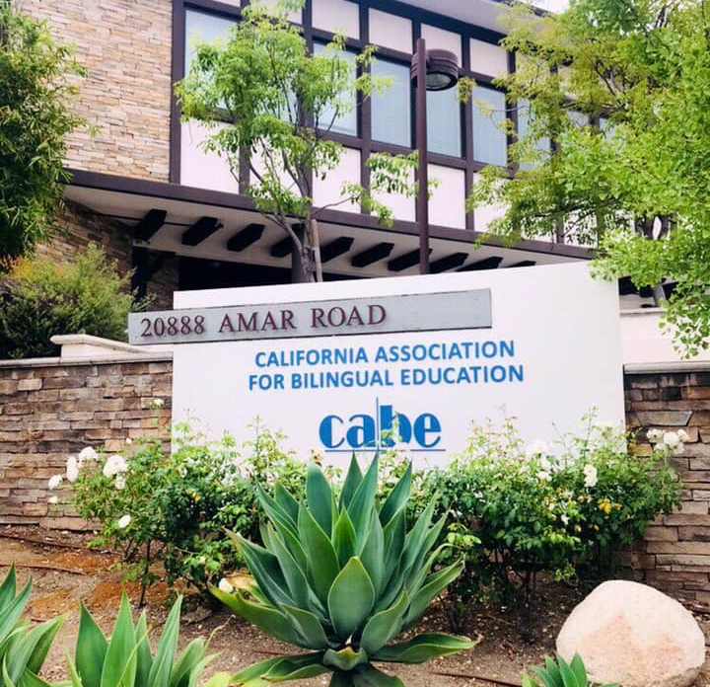
CABE PROGRAM UPDATES
September 26, 2020
PRESENTED BY:
ALMA CASTRO • DELMA CHWILINSKI • JAN GUSTAFSON-COREA • JOSHUA JAUREGUI • NORMA ROCHA • MARIA VILLA

Slide 2

STRATEGIC PLAN
FOCUS AREAS
FAMILY & COMMUNITY ENGAGEMENT
PROFESSIONAL LEARNING/CONFERENCES
PROFESSIONAL LEARNING/PROFESSIONAL DEVELOPMENT
MEMBERSHIP
WEB & PRINT COMMUNICATIONS
ADVOCACY
BUDGET & FUND DEVELOPMENT
COMMUNICATIONS & PUBLIC RELATIONS
MULTILINGUAL EXCELLENCE
RESEARCH & POLICY BRIEF DEVELOPMENT

Slide 3



ITCD—NORMA ROCHA
WEB & PRINT COMMUNICATIONS

Slide 4

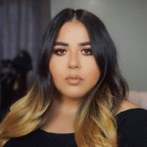


CABE’S Information Technology & Creative Design Department
Karmina Ramirez is now part
of the ITCD Department
Karmina Ramirez,
Digital Media & IT Assistant
CABE is BLOWING UP on Social Media!
CABE is constantly sharing news on social media via various platforms! Our following grows each day and our popularity shows!
CABE Facebook | MCAP Facebook | CABE Instagram | CABE Twitter | CABE LinkedIn | FB Resource Group | Email Blasts | CABE Website | MCaP Website | Resources Website | Online Community | 2021 Website
Online/Virtual Growth!
The CABE Team has adapted to these changing times to bring our usual events, plus MORE, to those who serve English Learners and their families by receiving training in Zoom.
P2I Contract Work | PDS Contract Work | PDS Back to Schools | MCaP Webinars | Committee/Board Mtgs | P2I Cafecito | PDS Teacher Strategies | Executive Mtgs | Summer DLI | CABE 2020 Virtual | CABE 2021
CABE Now Has 11 Zoom Accounts!
We now have 11 Zoom accounts to carry out CABE work! We have developed protocol to share these accounts as a team and calendar events for webinars that support up to 100 participants and Large Meetings that support up to 500 participants.

Slide 5
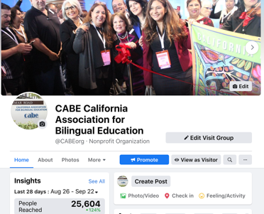
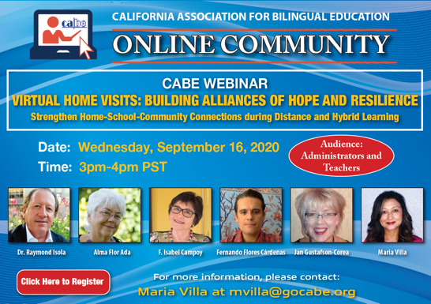
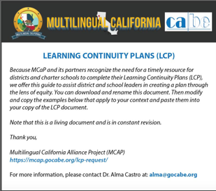








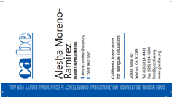

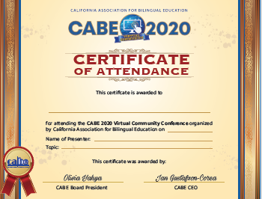

CABE’s Branding & Visual Identity is #CABESTRONG!
The ITCD Team is working hard to deliver products that are in line with the CABE brand. From brochures, graphics, flyers, announcements and websites – we strive to convey CABE’s message of equity and multiculturalism in a visual way!

Slide 6

AS&M• JOSUA JAUREGUI
MEMBERSHIP

Slide 7


MEMBERSHIP UPDATES
New Chapter—San Bernardino/SBCCC
Updated Membership Brochures
Online Membership Registration Updated and Back Online!
Chapter Rebates Out! Due October 1st
CABE Corner Highlights—by end of each month.
Website Updates

Slide 8

CABE PROGRAMS & EVENTS
P & E • DELMA CWHILINSKI

Slide 9
Programs and Events
DLI Summer Spanish Institute, June 29- July 2, 2020
  772 - Attendee Registrants
  7 - Exhibitor Registrants
CABE 2020 Refunds and Rollover Completed
Parent Regional Conferences Fall 2020 and Spring 2021
  300 Expected Attendance
CABE Racial Equity Series November 18, 2020 and January 27, 2021
  150 Expected Attendance
CABE 2021 Virtual Conference Registration Live on OMS, Tuesday, September 15, 2020 Website: CABE2021.org
• 5 Days: Tuesday, March 23-Saturday, March 27, 2021
  Daily General Sessions with Keynote, Speakers, Workshops and Awards
  Tuesday-Friday, 2:00pm – 7:00pm
  Saturday, 8:00am – 1:00pm
  Extra Early Bird Rate Deadline 11/20/20 – Register at: http://cabe.k12oms.org/1524-189991
  Attendee Registration
  - 500 Registration
  - 110 Presenters
CABE 2021 Exhibitors/Sponsors Virtual Exhibit Hall Marketplace)
  Registration Opens by Mid-October
  Tuesday – Friday 2:00 pm – 7:00pm
  Saturday, Closed/Appointments
  Sponsorship Opportunity Level Information
  Adjusted to Virtual Platform

Slide 10

FAMILY & COMMUNITY ENGAGEMENT
PFE MARÍA • VILLA MARQUEZ

Slide 11
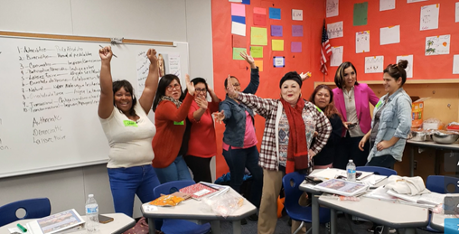
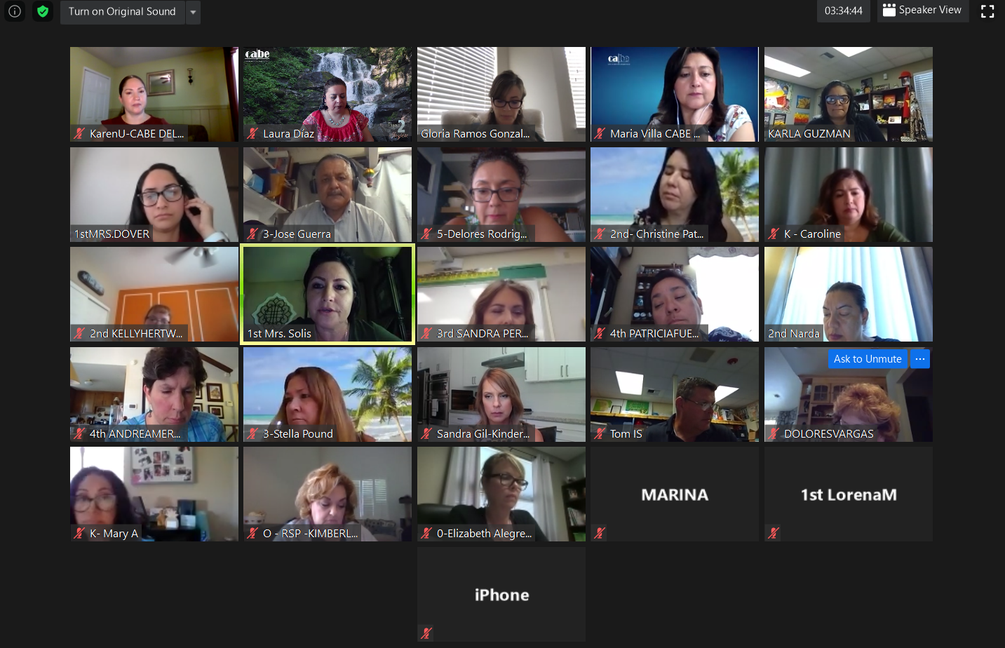

FAMILY & COMMUNITY ENGAGEMENT
Held three CAFECITO con CABE viz Zoom: Served over 500 parents
Project 2INSPIRE contracts $150,000 guaranteed as of September
Plaza Comunitaria Recipient of two grants Los Angeles $3000 & San Bernardino $ $4000
Mexican Consulate Professional Develop Training with 10 Consulates Offices across the state and IME
Support for Immigrant Families Virtual Trainer of Trainers (Central Valley) Session September 25th and October 9th (Led by Mari and Gricelda)
CEI: Request for Application has been extended till Sept 28th. Please share with your partner district the documents shared this morning
CDE SPAC Leadership training this Saturday led by Laura
Distance Learning Support to Districts led by Toni
Virtual Home Visit Webinar: Connecting with Families Virtually (Approximately 60 attendees)
Participation and Presentations in OCOE Interpreter and Translator Conference and San Bernardino County Superintend of Schools Summit
Finalizing a 6 Module Curriculum for Newcomer Families (Mari and Gricelda)

Slide 12


CABE PROFESSIONAL LEARNING
• CABE PDS
• MCAP
PL/PDS • RUBÍ FLORES/ALMA CASTRO

Slide 13
CABE PROFESSIONAL LEARNING
PROFESSIONAL DEVELOPMENT SERVICES
Professional Learning Team
Members Update:
  MCAP Grant Director: Dr. Alma Castro
  MCAP Administrative Assistant: Alexandria Ramos
  Professional Learning Specialist: Anya Bobadilla
  Karmina Ramirez Transitioning to ITCD
Part-time Professional Learning
Specialists:
  Karin Foster
  Dr. Nathalie Longree-Guevara
  Linda Hardman-Greene
Resources
Teaching strategy Webinars on Online Community
Creating guidelines for Distance Learning
MCAP website
Contracts: Currently supporting 18 Districts
Back to School Series- July/August
  3 Sessions on ELD and 3 on DLI
  Averaged 300 registrations per strand (ELD/ DLI)
Official Launch of the Dual Language Teacher Academy
  8 Sessions (2 in English/ 6 in Spanish)
  1 Saturday per month from 9:00-3:00, First session Sept. 26th, 2020
  140 registered participants for All 8 sessions and an average of 25 registered for individual sessions - Registration is still open for sessions 2-8
CABE ELD Workshop Series—Fall 2020
  2nd round of updated Back to School ELD Workshops
  Three 2-hour Sessions over 3 weeks presented by Amanda Gonzalez
  Tuesday October 27, Tuesday November 3, Tuesday November 10, From 3:30-5:30
  Registration link and flyer in the works. Registration to open next week

Slide 14


Slide 15
MCAP Multilingual California Updates
MCAP ALLIANCE—BUILDING OUR FOUNDATION
  Liberatory Design Training 8/26 & 8/27 (45 attended)
STAGE 1-Statewide
  MCAP Website https://mcap.gocabe.org/ (115 people registered for updates
  Learning Continuity Plan Recommendations released 9/16
    62 people accessed so far….
  Fall MCAP webinar series started on 9/23 (next 10/7)
    392 participants
STAGE 2—MCAP ALLIANCE & 30 LEAs, 5-10 IHEs
  Superintendent Forum & Regional Summits in the Fall
  Innovations/Professional Learning
Notes:
10/7 @58 registrations already! :)

Slide 16
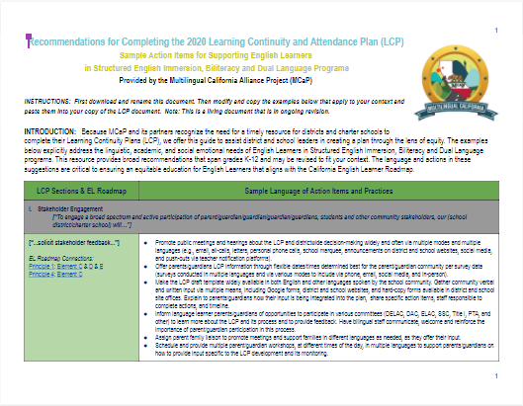
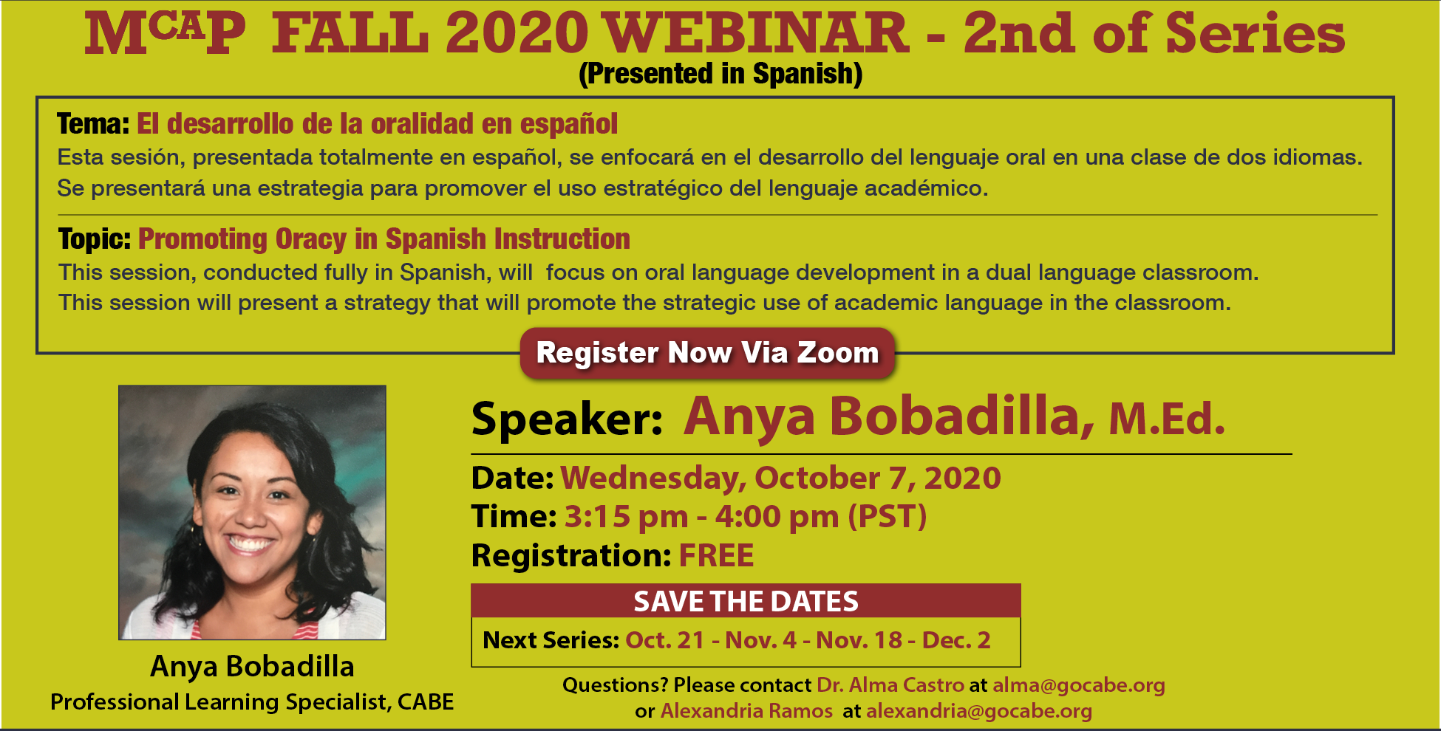

  MCAP Fall Webinar Series
  9/23
  10/7 & 10/21
  11/4 & 11/18
  12/2
  3:15pm (45 mins)
  LCP Document
  Social Media
LCP

Slide 17

Big ideas come from forward thinking people who challenge the norm, think outside the box, and invent the world they see rather than submitting to the limitations of current dilemmas.
TD Jakes
This Photo by Unknown Author is licensed under CC BY

